Slide 1
TENDER NUMBER: TNPA/2023/09/0002/42116/RFP COMPULSORY CLARIFICATION MEETING FOR: PROVISION OF DESIGN, MANUFACTURE, DELIVERY, INSTALL, AND COMMISSIONING OF SECURITY FENCING UPGRADE AT THE PORT OF CAPE TOWN FOR A PERIOD OF TWELVE (12) MONTHS VENUE: TNPA MARITIME TRAINING CENTRE (RED HOUSE OPPOSITE SAPS POLICE STATION), 1 COODE CRESCENT, 1ST FLOOR, PORT OF CAPE TOWN DATE: 16 April 2024 TIME: 11H00
PRESENTED BY: Mbaliyamaswazi Maqekeni
Notes:
Growth and Reinvent

Slide 2
BACKGROUND & SCOPE OF WORKS

Slide 3
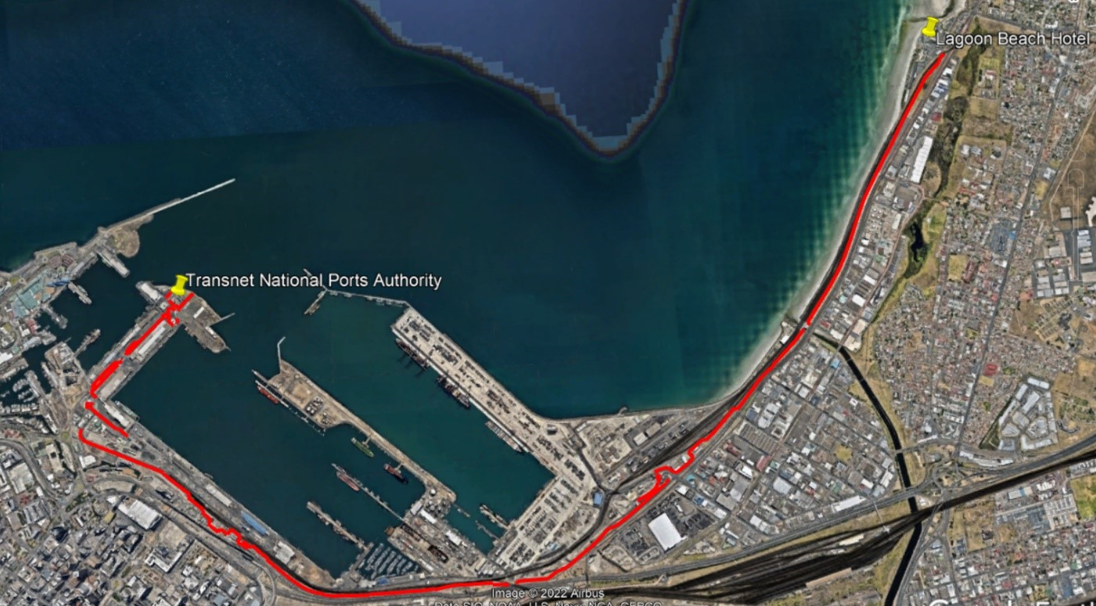
BACKGROUND
The National Port Security Fencing Upgrade project is aimed at replacing and upgrading security fencing in the Port of Cape Town to meet the minimum requirements of the ISPS code, ensure compliance with the relevant legislation and regulatory framework standards as well as address any security concerns posed by the condition of the existing fencing.
The Port of Cape Town is located in Table Bay, Cape Town. The perimeter fence that is to be replaced runs from TNPA House (North-West side of the Port) to Lagoon Beach Hotel in Milnerton (towards the North-East). The perimeter fence is highlighted in red in Figure 1 below.

Slide 4
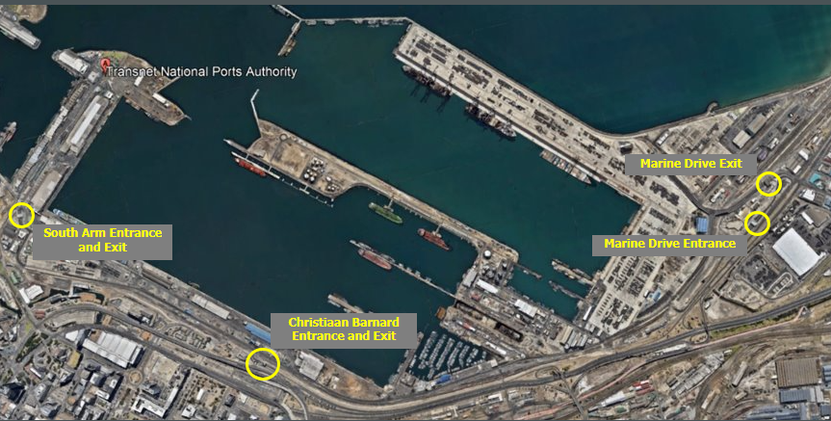
BACKGROUND
The Port of Cape Town is located in Table Bay, Cape Town. The main pedestrian access points in Figure 2 below

Slide 5
SCOPE OF WORKS
The Employer and owner of the works, Transnet National Port Authority (TNPA), aim to meet the requirements of the ISPS code, ensure compliance with the relevant legislation and regulatory framework standards as well as address the security concerns and risks through the execution of this project. The Employer’s objective is to replace the current steel palisade fence with welded mesh fencing. The welded mesh fencing has a long design life and requires minimal maintenance. The fence is robust and cannot easily be damaged in comparison with the other options considered. The welded mesh is designed to withstand harsh and corrosive environments and cannot easily be scaled, greatly improving the ports’ security measures.
The Employer’s objectives are to:
Replace the existing steel palisade fencing with welded mesh fencing, providing a perimeter security fence that will demarcate the port boundary and restrict access to the port area.
Meet the requirements of the ISPS code, ensure compliance with the relevant legislation and regulatory framework standards as well as address the security concerns and risks.
Achieve completion of the Works by meeting the completion date whilst maintaining the highest environmental, quality, and safety standards, minimizing disruptions to ongoing port and terminal operations.

Slide 6
SCOPE OF WORKS
The Contractor is responsible for executing and providing designs, drawings, and/or information for the following parts of the works:
Supply and construction of fencing (perimeter and other):
Replace the current fence with new welded mesh fencing in all areas specified in this document. The new fence should be modern and sturdy with no gaps or points of entry. The fence should be anti-climb, anti-cut, and anti-burrow. All fences supplied should be coated to protect against corrosion associated with the coastal environment.
Supply and construction of gates:
A variety of swing and sliding gates, either manual or automated, are to be installed at various locations throughout the Port as specified in this document. All swing gates and sliding gates should match the new welded mesh fence and should be well-lubricated to operate smoothly and efficiently. All gates are to be tamper resistant and should be coated to protect against corrosion.
Concrete foundations:
The new fence shall be secured to the foundations of the existing fence. If the exposed parts of the concrete foundation are damaged, have cracked, or have experienced spalling or any other defect as stated in SANS 2001-CC1, concrete patchwork will be necessary to rehabilitate and repair the foundations. The fence should not be erected on top of any concrete patchwork. Any defects to the concrete foundations and plinths will be repaired using suitable repair methods and products upon approval by the engineer. In the instance where no existing foundation is present, or the existing is found to be insufficient, a new suitable foundation shall be constructed.

Slide 7

SCOPE OF WORKS
Please reference Part 3 Scope of works for detailed information.

Slide 8

QUESTIONS AND ANSWERS

Slide 9
EVALUATION METHODOLOGY

Slide 10
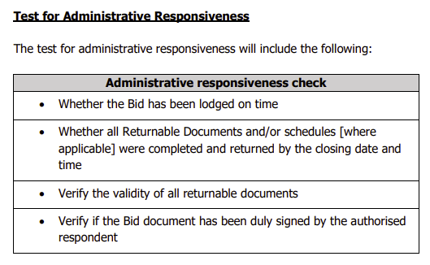
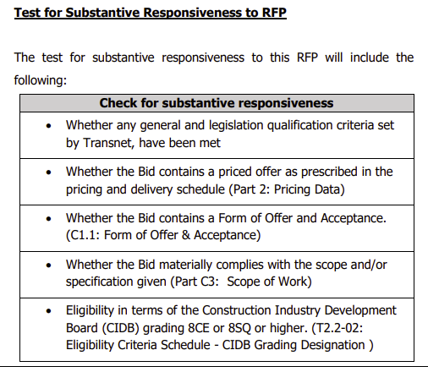
STEP ONE: TEST FOR ADMINISTRATIVE RESPONSIVENESS
The test for administrative responsiveness will include the following:

Slide 11
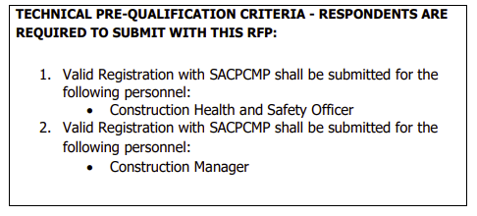
STEP ONE: TEST FOR ADMINISTRATIVE RESPONSIVENESS
The test for administrative responsiveness will include the following:

Slide 12
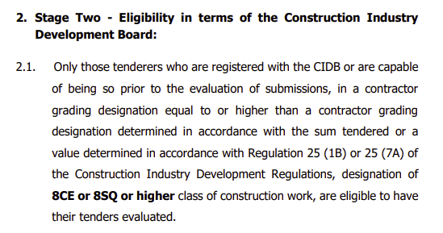
STEP TWO: TEST FOR SUBSTANTIVE RESPONSIVENESS TO RFP
The test for substantive responsiveness to this RFP will include the following:
The test for substantive responsiveness [Step Two] must be passed for a Respondent’s proposal to progress to Step Three for further evaluation

Slide 13
QUESTIONS AND ANSWERS

Slide 14
FUNCTIONALITY/TECHNICAL EVALUATION
2023 Date: June

Slide 15
STEP THREE: FUNCTIONALITY CRITERIA(Technical Evaluation)
Only those tenderers who attain the minimum number of evaluation points (60) will be eligible for further evaluation, failure to meet the minimum threshold will result in the tender being disqualified and removed from further consideration.
Qualifying Quality Criteria | Total Number of Points
T.2.2-03 Detailed Organogram, Curriculum Vitae (CV’s), Qualifications | 15
T2.2-04: Tenderer’s Previous Experience | 10
T2.2-05: Evaluation Schedule: Programme | 10
T2.2-06: Health and Safety Requirements | 15
T2.2-07: Method Statement | 20
T2.2-08: Evaluation Schedule - Quality Management | 15
T2.2 -09 Environnemental Management | 15
Maximum score for functionality | 100

Slide 16
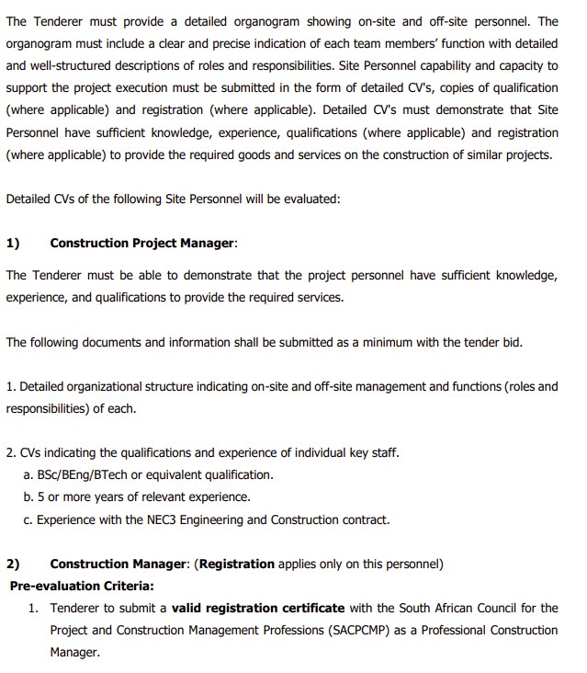
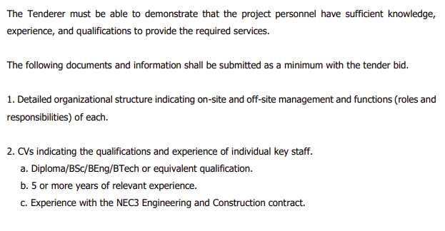
T.2.2-03: Detailed Organogram, Curriculum Vitae (CV’s), Qualifications (15 points)

Slide 17
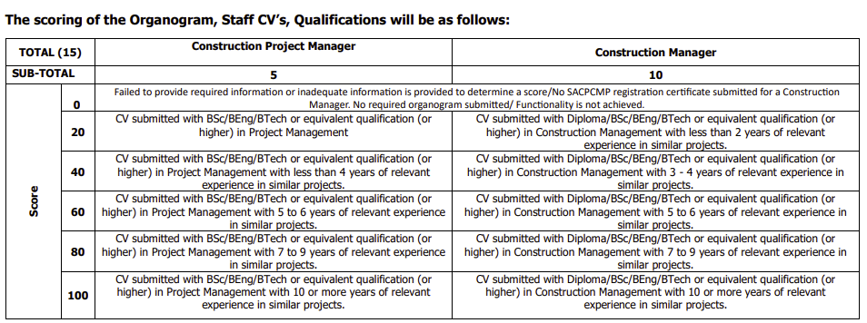
T.2.2-03: Detailed Organogram, Curriculum Vitae (CV’s), Qualifications (15 points)

Slide 18
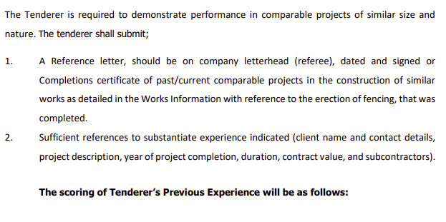
T2.2-04: Tenderer’s Previous Experience (10 points)

Slide 19
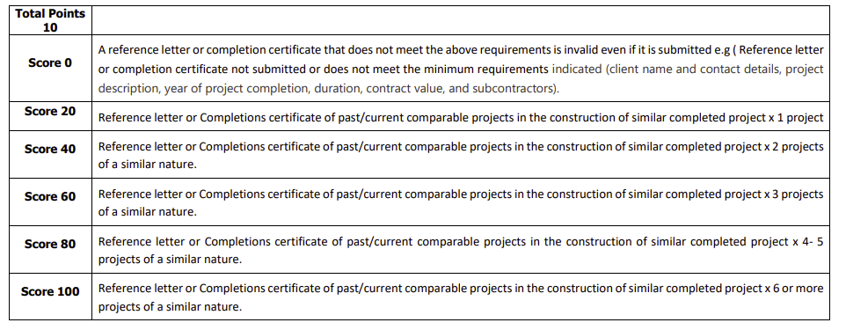
T2.2-04: Tenderer’s Previous Experience (10 points)

Slide 20
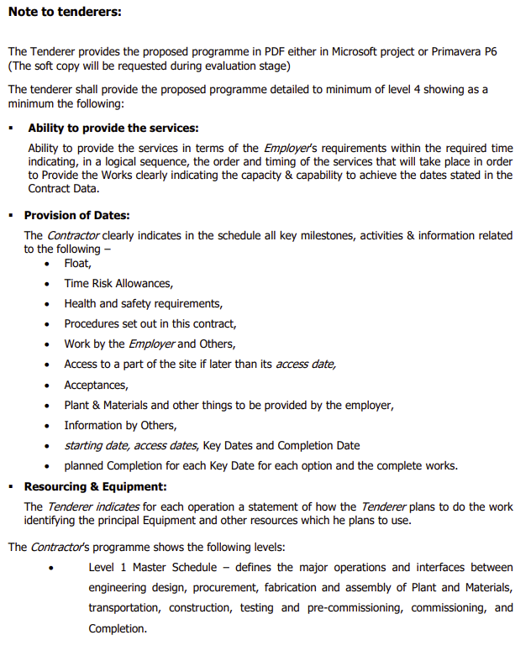
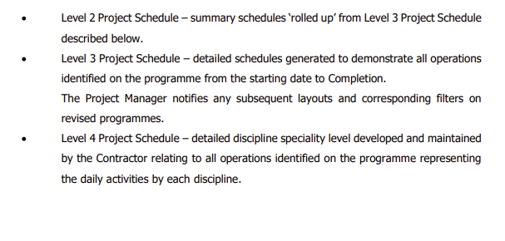
T2.2-05: Evaluation Schedule: Programme (10 points)

Slide 21
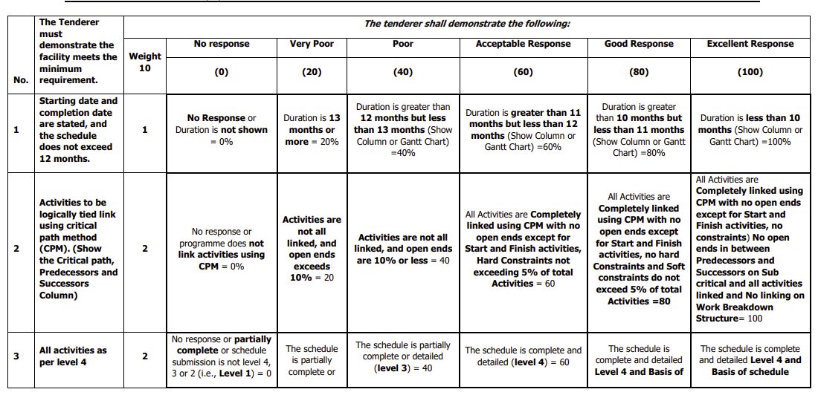
T2.2-05: Evaluation Schedule: Programme (10 points)

Slide 22
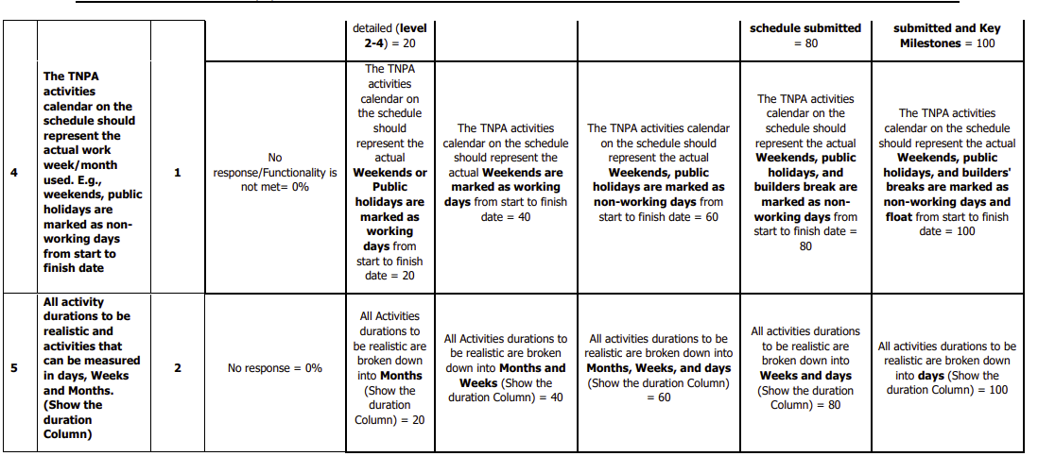
T2.2-05: Evaluation Schedule: Programme (10 points)

Slide 23
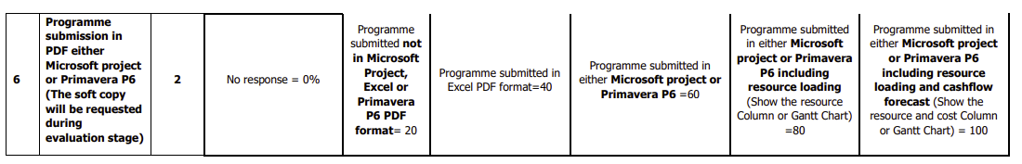
T2.2-05: Evaluation Schedule: Programme (10 points)

Slide 24
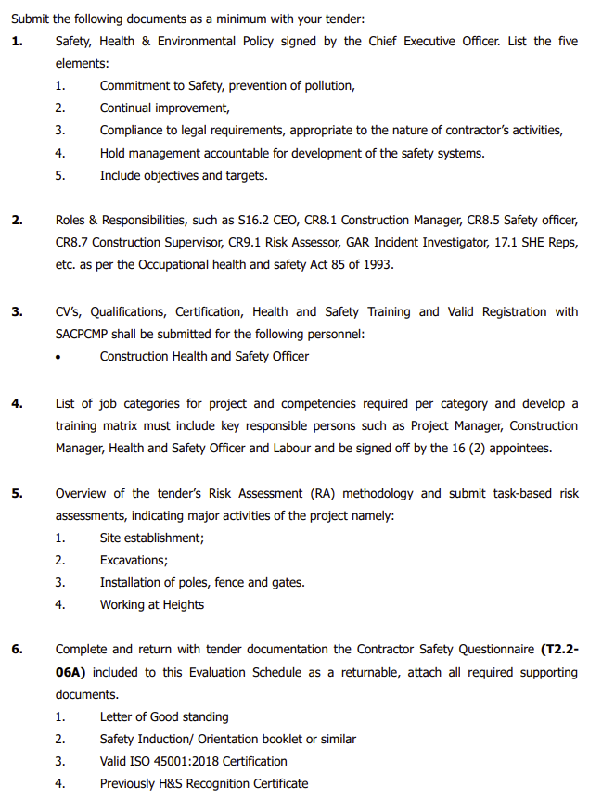
T2.2-06: Health and Safety Requirements (15 points)

Slide 25
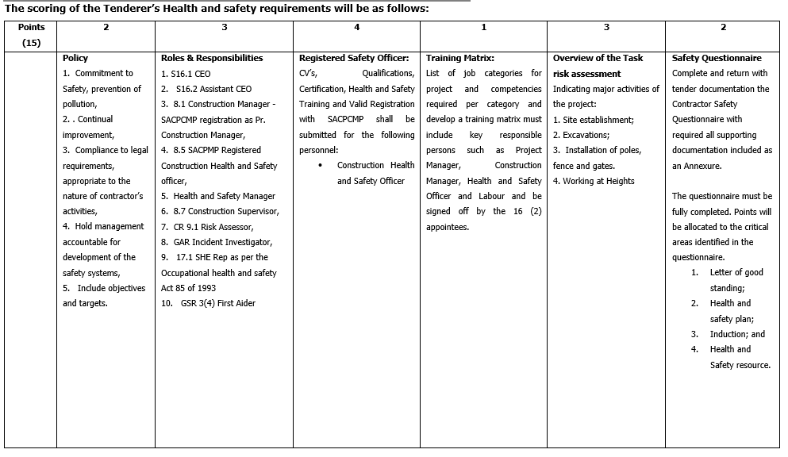
T2.2-06: Health and Safety Requirements (15 points)

Slide 26
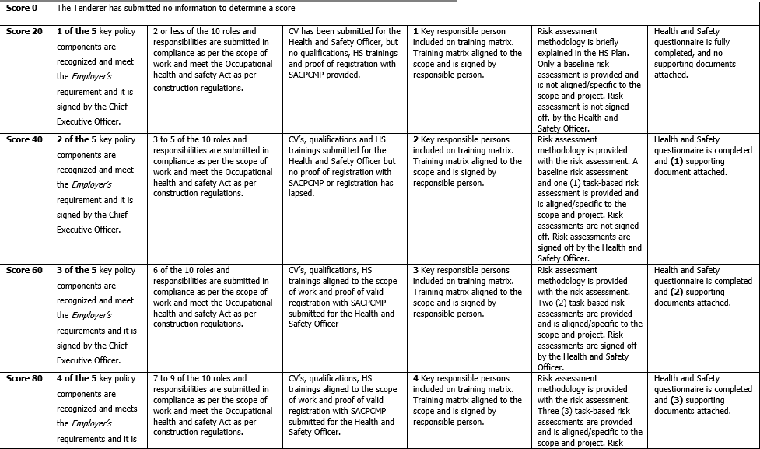
T2.2-06: Health and Safety Requirements (15 points)

Slide 27
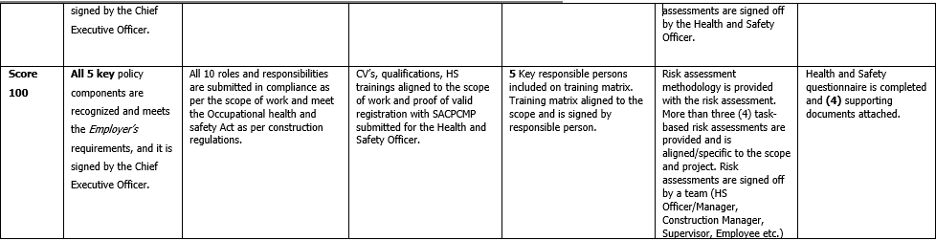
T2.2-06: Health and Safety Requirements (15 points)

Slide 28
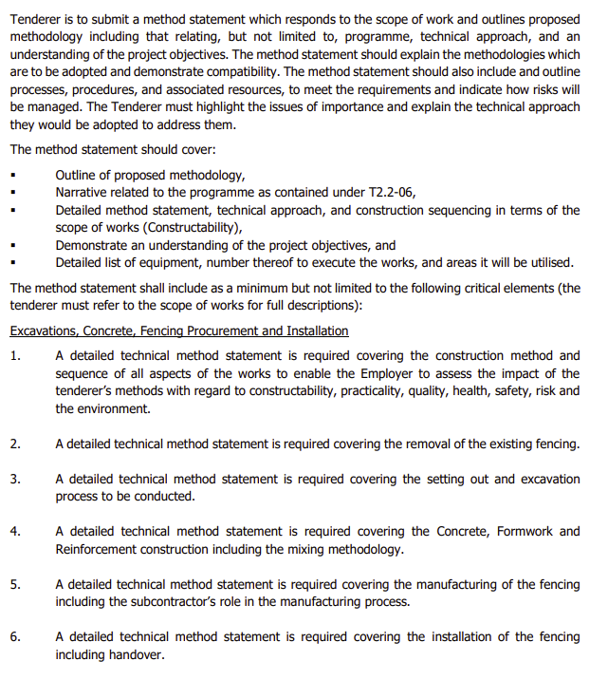
T2.2-07: Method Statement (20 points )

Slide 29
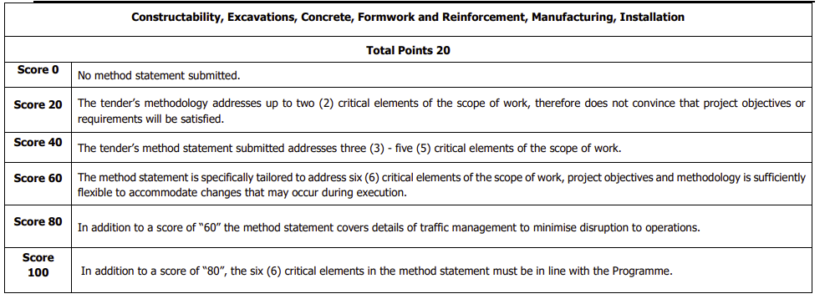
T2.2-07: Method Statement (20 points )

Slide 30
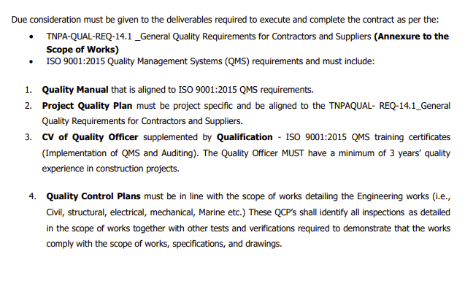
T2.2-08: Evaluation Schedule - Quality Management

Slide 31
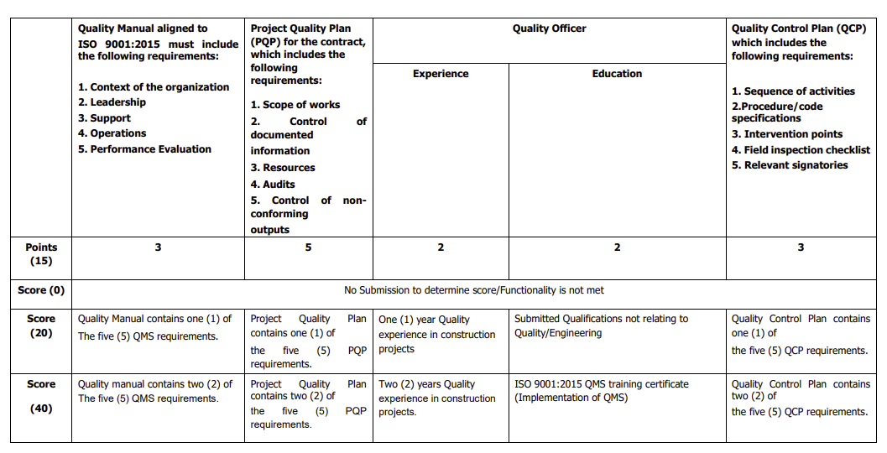
T2.2-08: Evaluation Schedule - Quality Management

Slide 32
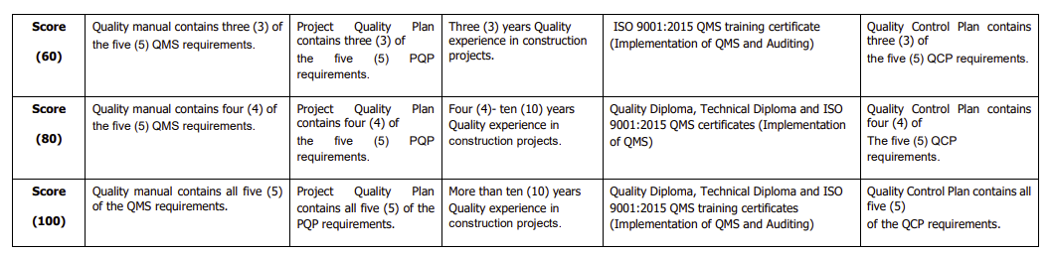
T2.2-08: Evaluation Schedule - Quality Management

Slide 33
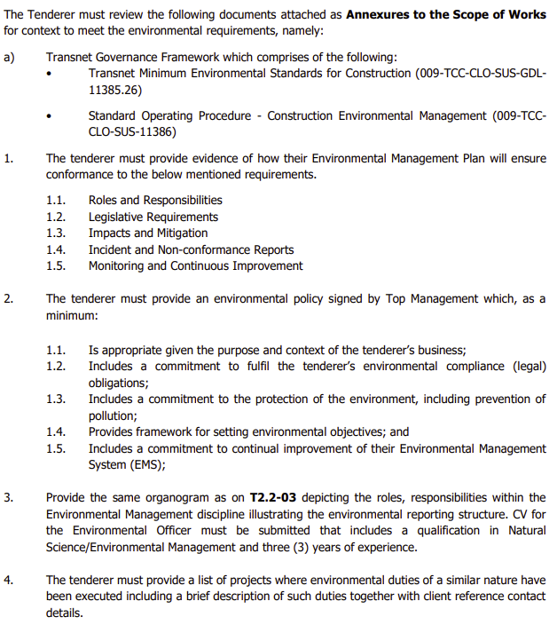
T2.2 -09 Environnemental Management (15 points)

Slide 34
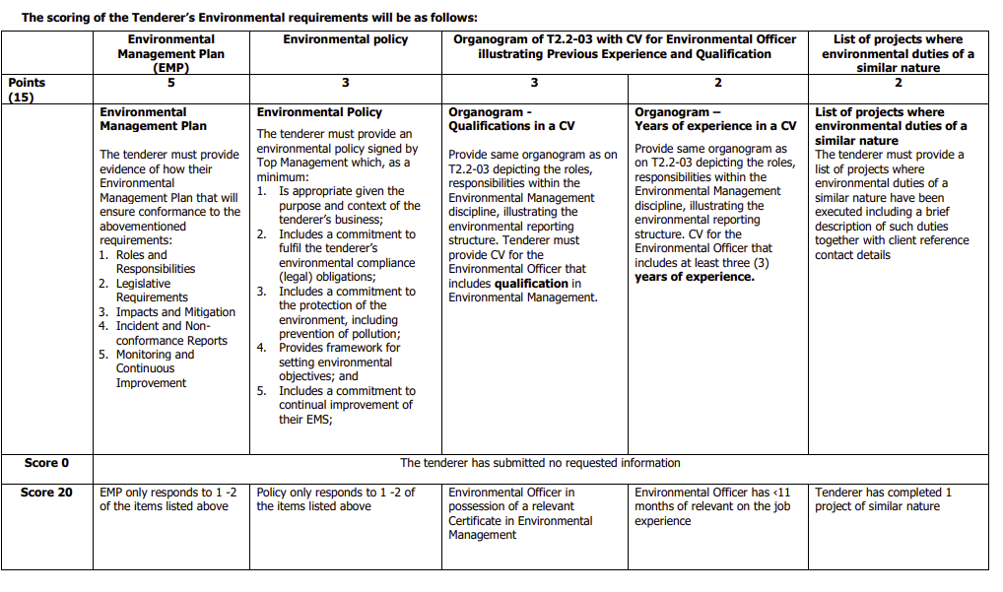
T2.2 -09 Environnemental Management (15 points)

Slide 35
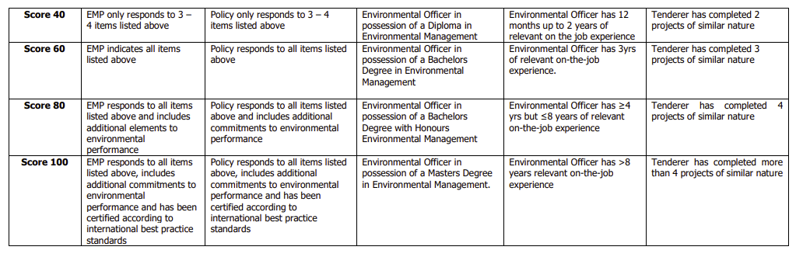
T2.2 -09 Environnemental Management (15 points)

Slide 36
QUESTIONS AND ANSWERS

Slide 37
CONTRACT DATA
37

Slide 38
CONTRACT DATA
Form of agreement
Form of contract: NEC ECC
Main Clause: Option B: Priced contract with bill of quantities
W1: Dispute resolution procedure
Secondary Clause:
X1: Price adjustment for inflation
X2: Changes in the law
X4: Parent company guarantee
X7: Delay damages
X13: Performance Bond
X16: Retention
X18: Limitation of liability
Z: Additional conditions of contract

Slide 39
PRICING INSTRUCTION: BILL OF QUANTITIES
39

Slide 40
C2.2 Bill of Quantities
ITEM | DESCRIPTION | AMOUNT
 | Security Fencing upgrade at the Port of Cape Town
BILL NO. 01 | PRELIMINARIES AND GENERA
BILL NO. 2 | DEMOLITIONS etc.
BILL NO. 03 | FENCING
BILL NO. 04 | INSTALLATION OF FENCE
BILL NO.05 | SECURITY PERIMETER GROUND BEAM CONCRETE, FORMWORK AND REINFORCEMENT
BILL NO. 06 | PROVISIONAL SUM
BILL NO. 07 | GATES
BILL NO. 08 | AUTOMATION
BILL NO. 09 | TURNSTILES
BILL NO. 10 | ELECTRIC FENCING
Carried forward to the C1.1 Form of Offer and Acceptance |  | R

Slide 41

QUESTIONS AND ANSWERS SESSION:

Slide 42
SITE VISIT
2023 Date: June

Slide 43
Site visit
A Site visit/walk will take place, tenderers are to note:
Tenderers are required to wear safety shoes, goggles, long sleeve shirts, high visibility vests and hard hats.
Tenderers without the recommended PPE will not be allowed on the site walk.
Tenderers and their employees, visitors, clients and customers entering Transnet Offices, Depots, Workshops and Stores will have to undergo breathalyser testing.
All forms of firearms are prohibited on Transnet properties and premises.
The relevant persons attending the meeting must ensure that their identity documents, passports or drivers licences are on them for inspection at the access control gates.

Slide 44
THANK YOU ALL;
2023 Date: June

